Slide 1
AI Career Pathway &
Labor Market Intelligence Platform
Integrative Industry Synthesis Defense
Zhirui Wang | Udacity Master of AI | March 2026

Slide 2
Industry Context & Problem Definition
Industry: Workforce Development / HR Tech / EdTech
Workers lack clear visibility into viable career transitions
Key unknowns: skills to develop, salary trade-offs, growth outlook, automation risk
Employers & policymakers lack tools for transition feasibility and skill-gap intelligence
Existing job platforms often provide generic advice (not evidence-based pathways)
2
Goal: evidence-based, personalized pathways — framed as decision support (not guarantees).

Slide 3
Why AI Is Appropriate
This problem benefits from combining multiple AI paradigms:
Data Pipeline
Statistical Analysis
Pull and process labor market data (0*Net, BLS)
Labor market metrics (growth, salary, opportunity scores)
ML / Recommender
Agentic Workflows
Skill similarity + ranking of transition options
Tools + orchestration to resolve input and produce roadmaps
3

Slide 4
Integrated System Overview
AI Career Pathway & Labor Market Intelligence Platform (Streamlit)
User Flow
Key Outputs
Enter current occupation (natural language)
System resolves the occupation
Ranked career transitions returned
Skill gaps + metrics shown
6–12 month narrative roadmap generated
Ranked transition table
Growth & salary metrics
Risk-adjusted opportunity score
Skill / knowledge / ability gaps
Roadmap (markdown narrative)
Design principle: one coherent pipeline with defined handoffs
4

Slide 5
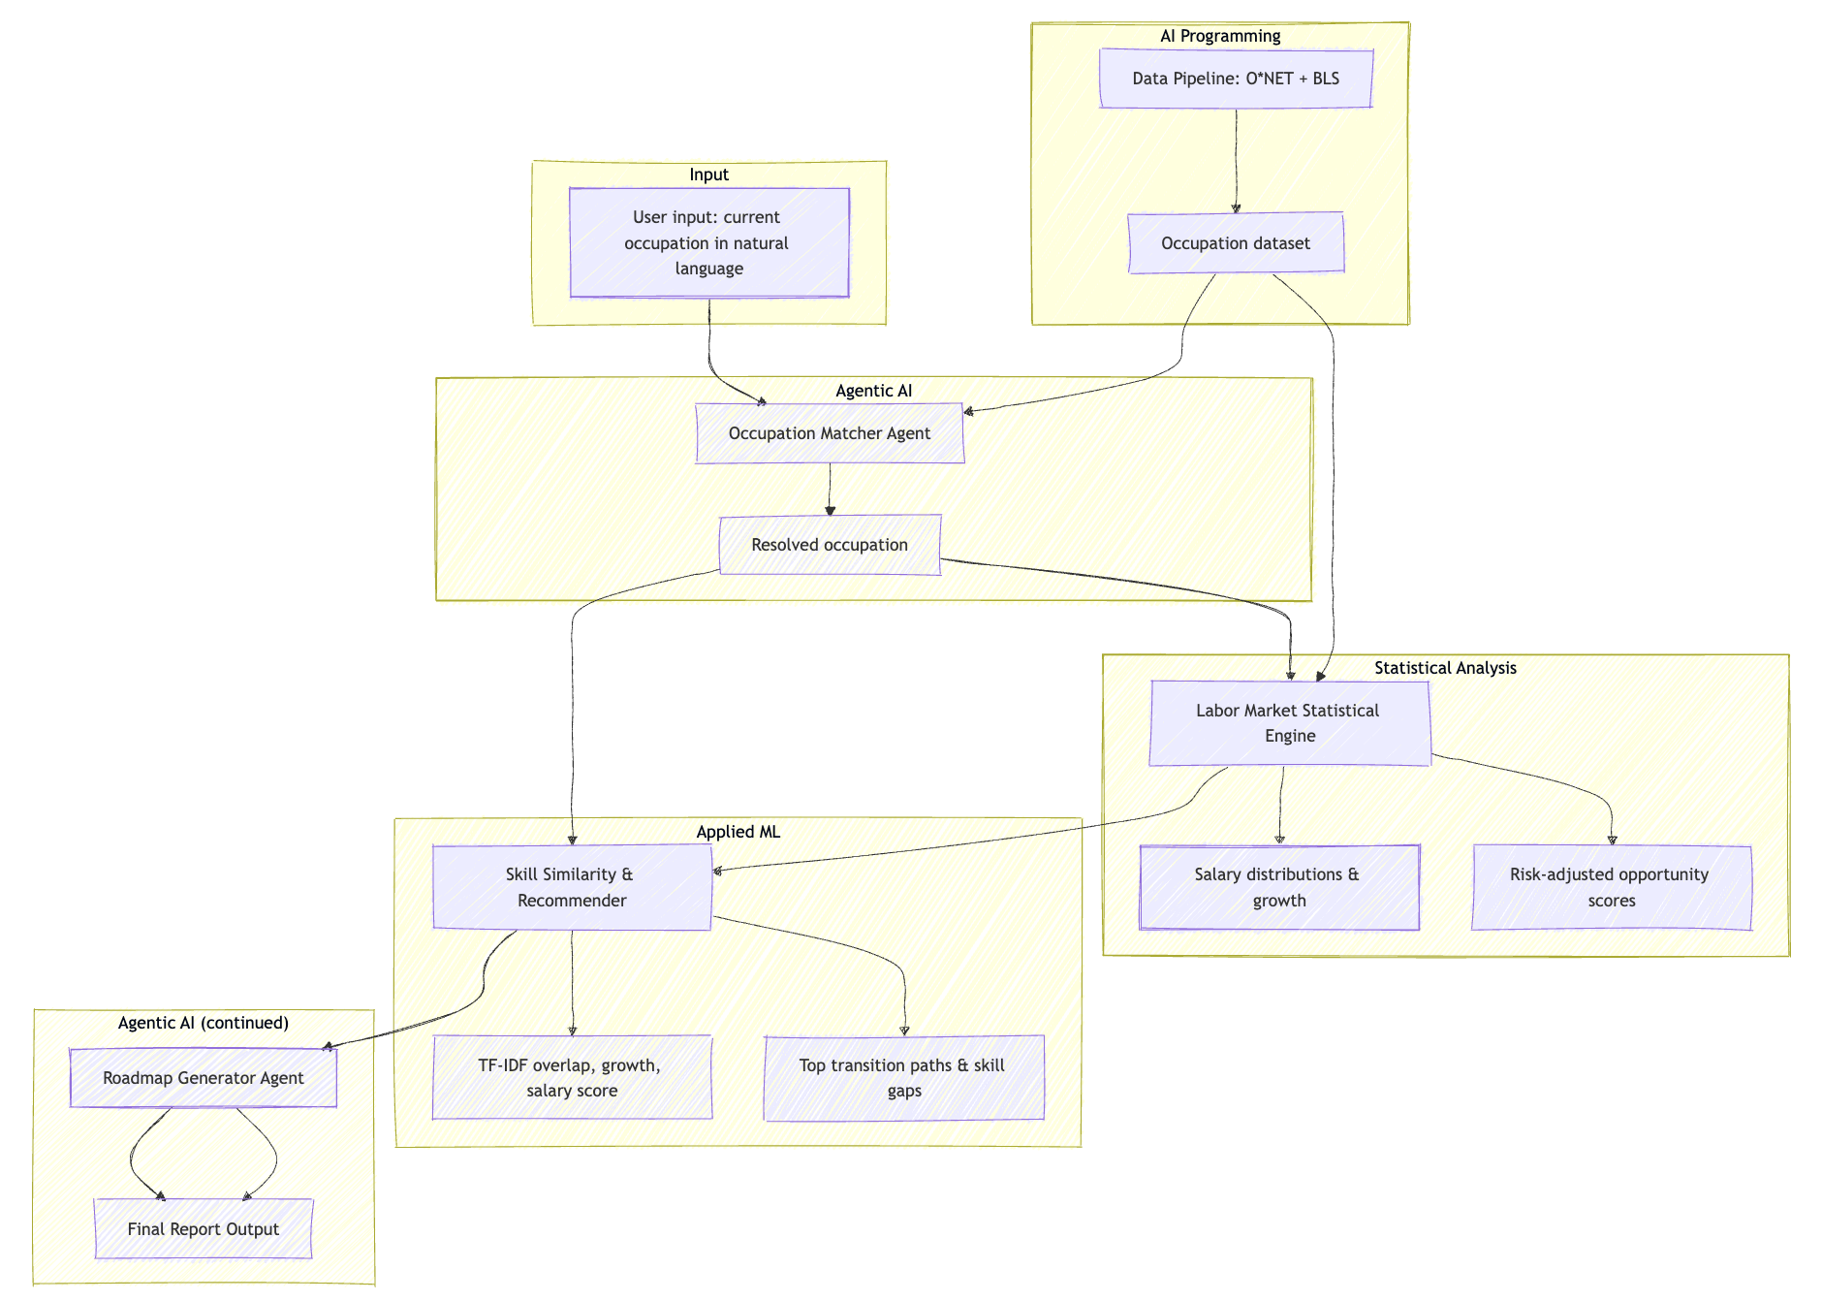
System Architecture (End-to-End Flow)
5

Slide 6
Integration of Prior Capstones
This project integrates four prior capstone domains in code:
Capstone 1 — Data Workflow
Reproducible O*NET + BLS pipeline (refresh-data CLI)
Capstone 2 — Statistics
Growth, salary distributions, risk-adjusted opportunity scores
Capstone 3 — Applied ML
TF-IDF + cosine skill similarity; weighted recommender; gap extraction
Capstone 6 — Agentic AI
Occupation matcher agent + roadmap generator agent (tool-using orchestration)
6

Slide 7
Key Technical Decisions & Tradeoffs
TF-IDF + Cosine Similarity (vs embeddings)
Interpretable and fast
No external API dependency
Sufficient for a demo recommender
Tradeoff: may lose nuance vs embeddings
Transparent Weighted Score
Score = 0.8×overlap + 0.1×growth + 0.1×salary (normalized)
Tunable and explainable
Tradeoff: fixed formula vs learned model
Agentic Orchestration with Tools
Occupation matcher agent resolves user input
Roadmap generator agent produces narrative plan
Tradeoff: quality depends on tool context + prompting
7

Slide 8
Ethical Considerations & Responsible AI
Domain-specific risks (workforce decision support):
Risks
Safeguards
Bias/fairness: labor data can encode inequities
Overconfidence: users may treat estimates as guarantees
Automation displacement: recommending roles with hidden risk
Decision-support framing + clear disclaimers
Expose scoring logic and limitations
Recommend bias audits (disaggregated metrics) before deployment
Governance: accountability, audit cadence, feedback loops
8

Slide 9
Evaluation & What Worked
How it was evaluated
Qualitative: manual inspection of ranking coherence and roadmap quality
Execution: end-to-end Streamlit run to verify pipeline outputs
Example sanity check: Web Developer → Computer & Information Research Scientist
Strengths observed
Coherent integration across statistics, ML/recommender, and agents
Observable outputs: rankings + gaps + narrative roadmap
Reproducible and interpretable scoring and handoffs
9

Slide 10
Limitations & Risks
Current limitations (artifact scope):
Heuristic transition scoring (no trained model with labeled outcomes)
Static O*NET/BLS snapshot (no real-time job posting integration)
Risk of bias propagation if data encode inequities
Potential user over-reliance if probabilities are misinterpreted
Production readiness would require: real transition labels, larger taxonomy, user studies, fairness audits, and monitoring.
10

Slide 11
Professional Relevance
Skills demonstrated
System-level architecture thinking
Data + ML + agent integration
Interpretable recommender design
Reproducibility & modular code
Ethical reasoning grounded in domain
Clear communication of limitations
Decision-support framing
Professional documentation & reporting
11

Slide 12
Next Steps / Future Improvements
If extending toward production readiness:
Integrate live labor market APIs or periodic automated refresh
Collect/obtain labeled transition outcomes; train a transition feasibility model
Scale to a larger occupation taxonomy and richer skill representations
Run fairness audits + user studies; establish governance and monitoring
Add optional LLM roadmap generation with guardrails
Quantitative evaluation (e.g., AUC on held-out transition pairs)
12

Slide 13
Questions?
Happy to discuss: design choices • integration • ethics • limitations • deployment
Zhirui Wang
13

